Slide 1
Evolution and Generation of Computers
Samuel Kizito

Slide 2
Evolution in computer technology
Computer evolution refers to the change in computer technology right from the time computers were first used to the present.

Slide 3
The mechanical computer era (1623–1945)
mechanical computers were computers built from only moving mechanical components such as levers and gears, rather than electronic components.

Slide 4
The pascaline
The Pascaline was the first arithmetic machine invented by Blaise Pascal (1623–1662) who was a French mathematician, to do calculations such as additions and subtraction.

Slide 5
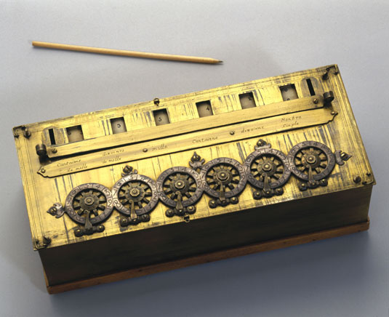

Slide 6
This machine had a set of wheels, each with the numbers zero through to nine on them.
This machine was of great use to his father, a judge in the taxation court, and to others involved in calculations.
Pascal‘s calculating machine was an essential step in the subsequent development of calculators and computers.

Slide 7
Its limitations
It was expensive to make
It was difficult to operate

Slide 8
Leibniz’s calculator/wheel
Gottfried Wilhelm Leibniz (1646–1716), a German mathematician, successfully introduced a calculator designed in 1673 but was completed in 1694.
The calculator could add, subtract, multiply, and divide.
It used wheels that were placed at right angles which could be displaced by a special stepping mechanism.

Slide 9
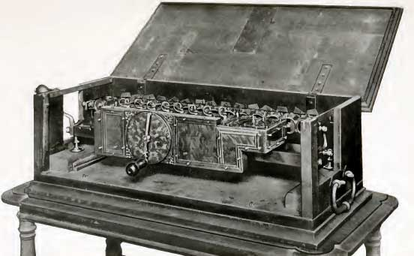
Leibniz Calculator

Slide 10
Its limitations
This calculator required that the operator using the device had to understand how to turn the wheels and know the way of performing calculations with the calculator.

Slide 11
John Napier’s bones
John Napier of Merchistoun (1550–1617), invented the logarithms and Napier’s bones, and popularised the use of the decimal point.

Slide 12
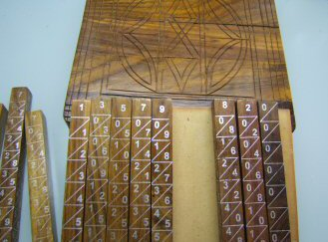
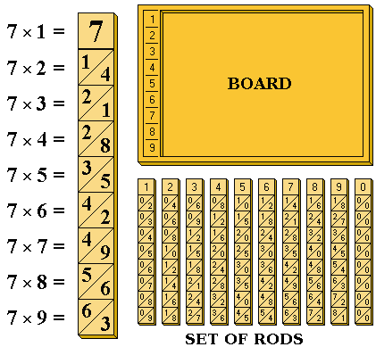
Napier Bones

Slide 13
Its relevance
Napier invented Logarithms to simplify multiplications and divisions calculations, by putting them to the level of addition and subtraction. The logarithm (or log) of a number to a given base is the power to which the base must be raised in order to produce that number.

Slide 14
It is a way of expressing one number in terms of a "base" number that is raised to some power. For example, 10³ = 1000, 3 is the log (logarithm), and 10 is the base. To multiply 10³×10⁵= 10⁸. The answer is derived by simply adding the logs of the two numbers (3+5=8). To divide 10⁸ ÷ 10⁴= 10⁴ , simply subtract (8-4=4)

Slide 15
The slide rule
The early slide rule was a calculating tool whose invention is associated with and based on John Napier’s invention of logarithms and Edmund Gunter's invention of logarithmic scales, it was invented in 1622 by William Oughtred, It was primarily invented for multiplication and division calculations, using two logarithmic scales, but was later developed to do other more complex calculations as well, such as roots, and trigonometry.

Slide 16
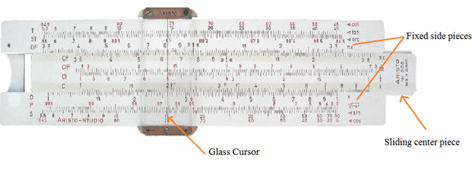

Slide 17
Shortcomings of the slide rule
The effective use of slide rules required one to understand the mathematics on which it is based, as well as the formulas being applied.
Use of the rule required the user to make some mental calculations while using the device.
Error levels in computation, especially due to mechanical imprecision in the slide rule due to wear and tear.

Slide 18
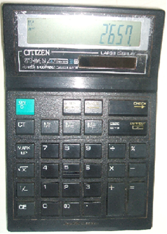

Slide 19
The Jacquard loom
This was invented In 1801–1805, the Frenchman Joseph Marie Jacquard, a silk-weaver, the Jacquard loom was an improved textile loom. It was the first machine to use punched cards. The punched cards controlled the weaving, enabling an ordinary workman to produce beautiful patterns in a style previously accomplished only with patience, skill, and hard work.

Slide 20
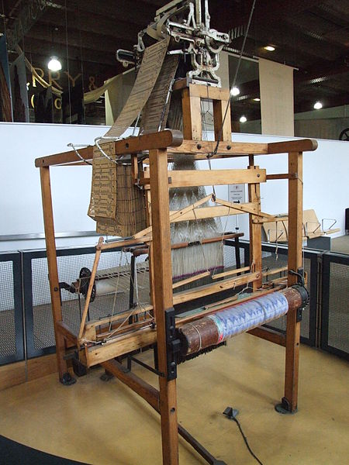

Slide 21
The Difference Engine and the Analytical Engine
Charles Babbage’s invented these machines which had a significant influence in computer development. He drew up detailed plans for mechanical calculating engines, both the table-making Difference Engines (1821) and the Analytical Engines (1837.

Slide 22
Three major factors influenced his work:
the desire to eliminate the high human error rate in the calculation of math tables at the time,
his experience working on logarithmic tables,
and the existing work on calculating machines earlier carried out by Blaise Pascal and Gottfried Leibniz.

Slide 23
Tabulating machine
Herman Hollerith developed a tabulating machine in the late 1800 which was known as the “unit record equipment” to process the punched cards when he was hired by the Bureau of Census, United States of America to make calculations of the 1890 population count. He used punched cards to store statistical information. Each card contained one record.

Slide 24
A punch card or punched card is a piece of either flexible or stiff paper that contains digital information represented by the presence or absence of holes in defined positions.

Slide 25
Electromechanical computers
An electromechanical computer is a machine with both mechanical and electronic components.
Main Example of this was the Automatic Sequence Controlled Calculator, usually called the MARK 1 which was able to multiply two 23-digit numbers in about six seconds or add the two numbers in about one third of a second.

Slide 26
Since it was electromechanical, it was incapable of speeds as high as those of the electronic computers being developed during the same period.

Slide 27
The Electronic Numerical Integrator and Calculator (ENIAC)
The Electronic Numerical Integrator and Calculator (ENIAC) Was completed in 1946 at the university of Pennsylvania. it consisted of more than 18,000 vacuum tubes (light bulb-like devices through which electric current can pass) and could perform 200 to 300 multiplications or 5000 additions per minute. It was a functional general purpose electronic computer,

Slide 28
Its weakness was that the program was wired into the computer. To change the program, it was necessary to rewire the computer.

Slide 29
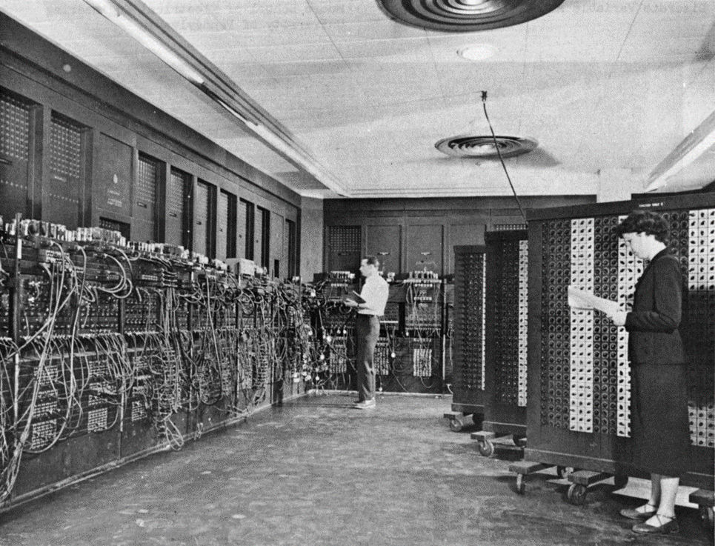
ENIAC
What is these features and their significance?
Describe this computer

Slide 30
The Electronic Discrete Variable Automatic Computer (EDVAC)
the Electronic Discrete Variable Automatic Computer (EDVAC) was the first computer to use the stored program concept.

Slide 31
Computer generations
A computer generation is a computer era(period of time) characterised by development and use of a particular computer technology that significantly changed the way computers operated.
Each new generation resulted in increasingly smaller, cheaper, more powerful, more efficient and reliable computing devices.

Slide 32
The Development of Computer technology is grouped into five generations.
Each generation is marked by advancement in basic technologies which have resulted in computers of lower cost, higher speed, greater memory capacity, and smaller size than computers of preceding/former generations.

Slide 33

The History of Computers

Slide 34
Computer generations and associated technologies
GENERATION | TECHNOLOGY
First generation | Vacuum tubes, Valves, Diodes
Second generation | Transistors
Third generation | Integrated circuits
Fourth generation | Very large Integrated Circuits.

Slide 35
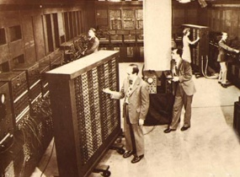
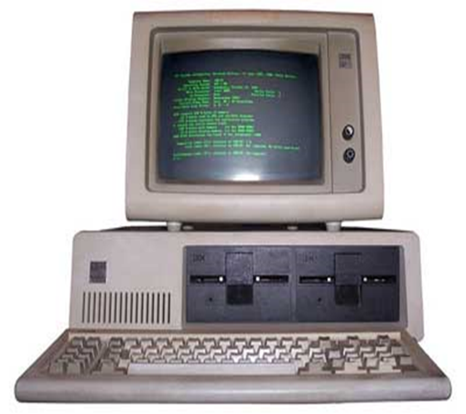
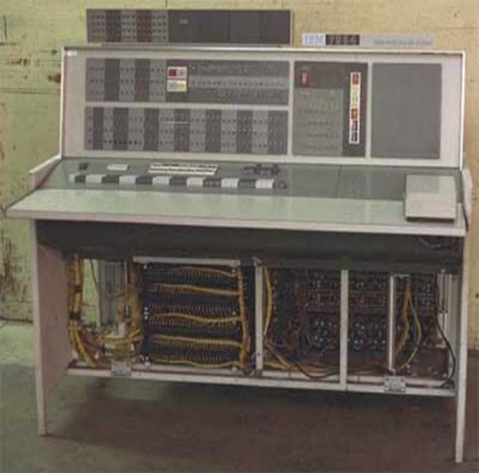

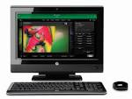
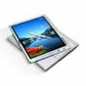
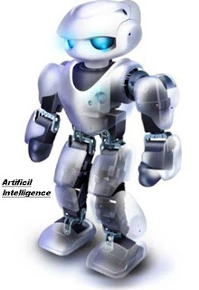

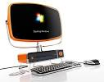
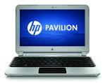
First generation
Third generation
Second generation
ENIAC
Identify the obvious differences
Fourth Generation
Fifth Generation

Slide 36
Characteristics of The first generation of Computers
This generation was marked by the use of vacuum tubes for circuitry.
The first generation computers did not use operating systems; instead each computer had its own machine language uniquely designed to run on that machine only.
Computers relied only on machine language to perform operations, machine language is the lowest-level programming language understood by computers, and they could only solve one problem at a time.

Slide 37
They used magnetic drums as primary storage. Magnetic drum is a metal cylinder coated with magnetic iron-oxide material on which data and programs can be stored.

Slide 38
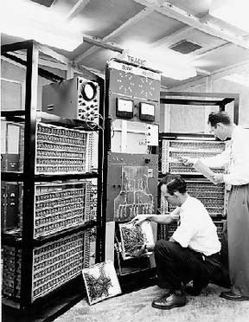
Identify the Nature of this computer?

Slide 39
They were very expensive to operate because they used a lot of electrical power to operate.
They generated a lot of heat due to use of very many Vacuum tubes, therefore needed air conditioning to cool.
They required constant maintenance and were difficult to maintain because vacuum tubes would be blown so easily, and processing was so unreliable.

Slide 40
Input was based on punched cards and paper tape, and output was displayed on printouts.
They were quite slow in processing data; millions of times slower than the current personal computers due to the use of vacuum tubes.
They needed a lot of power to work.
They had many moving parts like gears and levers.

Slide 41
The computers were very large, a single computer occupying a big room, therefore needed a lot of space to install. This was because vacuum tubes are very large
UNIVAC (UNIVersal Automatic Computer) and ENIAC (Electronic Numerical Integrator and Computer)where the first generation computers,

Slide 42
The ENIAC
This was the first operational electronic general-purpose computer, built in 1943, used 18,000 vacuum tubes. It was almost 30.5 meters (100 feet) long and had twenty 10-digit registers for temporary calculations. It used punched cards for input and output and was programmed with plug board wiring.
The ENIAC was able to compute at the rate of 1,900 additions per second.

Slide 43
The ENIVAC
The UNIVAC (UNIVersal Automatic Computer); like the ENIAC, it used stored programs. It was the first successful commercially available machine. It used more than 5,000 vacuum tubes and employed magnetic tape for bulk storage.

Slide 44
The Second computer generation
The use of Transistors replaced vacuum tubes.
The computers were much smaller due to the use of transistors,
They used less power because they became more energy-efficient and more reliable than their first-generation predecessors.
The computers produced less heat than the first generation computers.

Slide 45
The first supercomputer was made in the second generation. The CDC 6600, released in 1960s.
High-level languages were first used in the second generation computers. FORTRAN (FORmula TRANslator), the first high-level language, was developed in 1957 by IBM; COBOL (Common Business-Oriented Language), created for business applications, was developed in 1959.

Slide 46
High-level languages were first used in the second generation computers. FORTRAN (FORmula TRANslator), the first high-level language, was developed in 1957 by IBM; COBOL (Common Business-Oriented Language), created for business applications, was developed in 1959.
The computers in this generation were used for a wide variety of business and scientific tasks.

Slide 47
The first operating systems were implemented by The General Motors Research Laboratories in the early 1950s for their IBM 701.
The computers had a higher processing speed than first generation computers due to use of transistors that were more efficient than vacuum tubes,
They stored their instructions on magnetic cores as the internal memory .

Slide 48

Second Generation Computer
Is it different from computers of the first generation?

Slide 49
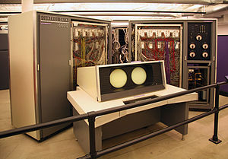
The CDC 6600 Super computer

Slide 50
Third computer generation
The development of the integrated circuit was the hallmark of the third generation of computers. Transistors were scaled down and placed on silicon chips, called semiconductors, which drastically increased the speed and efficiency of computers.

Slide 51

Third Generation computer
Describe the Nature of the Third generation Computer

Slide 52
Characteristics of the Third generation of computers
The use of integrated circuits (ICs) replaced transistors. An integrated circuit consists of thousands of circuits that have been put into a small chip of silicon.
Computer size further reduced due to the development of integrated circuits,
The use of magnetic disks used for storage of data, and computers began to support such capabilities as multiprocessing

Slide 53
Increased user friendliness due to use of Peripheral devices such as keyboards and monitors that were developed that permitted more efficient accessing of the data.
The cost of computers reduced compared 1st and 2nd generations, and for the first time, the computers became accessible to a mass audience.
Visual display terminals also came into use.

Slide 54
Simple programming languages like Basic were introduced.
Computers used much less power than in the 1st and 2nd generations.
Computers generated much less heat.
Operating systems were first used in the third generation like MULTICS (Multiplexed Information and Computing Service)which was an early time-sharing operating system.

Slide 55
The computers became much more reliability and there processing speed increased.
Networking was introduced.
Introduction of minicomputers.
The minicomputers were first used in the third generation.

Slide 56
The fourth computer generation
The Microprocessor brought the fourth generation of computers, as thousands of integrated circuits were built onto a single silicon chip. The Intel 4004 chip, developed in 1971, located all the components of the computer processor on a single chip.

Slide 57
Fourth Generation Computer
Describe the nature of the Fourth generation computers

Slide 58
Characteristics of Fourth generation computers (since 1971)
The use of microprocessors. In 1971, the first electronic computers that used Very large-scale integrated circuits (VLSI).
These computers had a much larger capacity to support internal memory.
This period also saw increased use of input and output devices that allowed data and instructions to be entered directly through the keyboard, the mouse and other handheld devices.

Slide 59
Fourth generation computers also saw the development of graphical user interfaces, the mouse and handheld devices.
Computers became much smaller and much more powerful.
There was wide spread use of a variety of computer software.

Slide 60
Computers became much cheaper than in the 1st,2nd and 3rd because microprocessors can be produces easily and in large quantities.
Computers became much faster than in any other generations because many transistors could be concentrated in a very small space, single-chip processors with on-board memory (called a cache) could be designed to allow more than one instruction to be executed at a time (called superscalar).

Slide 61
During the fourth generation, there has been an increase in the use of parallel processors. These computers combine many processors, linked in various ways, to compute results in parallel.
They have been used for scientific computations and are now being used for database and file servers as well.
Computers use much less power.
They generate much less heat.

Slide 62
The introduction of Micro- computers because of the tremendous decrease in size and cost of computers

Slide 63
The fifth generation of computers

Slide 64
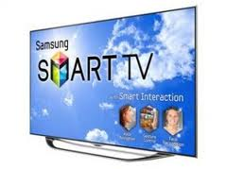
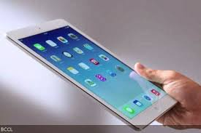
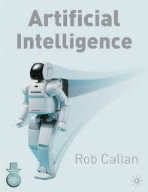
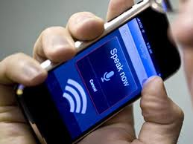
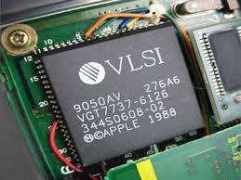
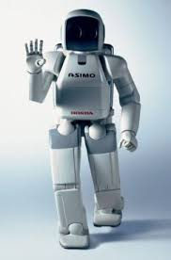

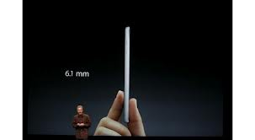

Describe the nature of the Fifth generation computers

Slide 65
Characteristics of fifth generation computers
The fifth generation computers use super large scale integrated chips.
They have artificial intelligence. Fifth generation computers are able to solve highly complex problem including decision making, and logical reasoning.
They are very small in size.
They are very fast because they are able to use more than one CPU for faster processing.

Slide 66
5.They are cheaper in cost.
6.They are characterised with voice recognition capability
7. Robotics in work places and homes.
8. Computers have a very high storage capacity.
9. A variety of storage devices are used.

Slide 67


Slide 68
Moore’s Law
According to Moore’s Law, the number of transistors on a chip roughly doubles every two years(18 months). As a result the size of computers gets smaller and smaller.
This was an observation made by Intel co-founder Gordon Moore in 1965. He noticed that the number of transistors per square inch on integrated circuits had doubled every year since their invention.

Slide 69
Moore’s law predicts that this trend will continue into the foreseeable future, making computers smaller and cheaper.

